Slide 1
Inflation at a Global Level
By
Aniv Chakravarty 11424113
Shridhar Kshirsagar 11541383

Slide 2
Introduction
The economy plays an important role in deciding the essential factors that contribute to the growth of a nation.
Tracking inflation is as valuable as tracking the rapidly changing stock market and may even be related.
Most economists and decision makers in the government look at inflation data when making key decisions like passing bills.
There are various international bodies that track and release the global data in large complicated tables.
Visualizing is key for faster and better understanding.

Slide 3
Data
Dataset captures information about global trends in inflation for the timeline of 52 years, i.e. 1970 through 2020.
It is made publicly accessible and available by kaggle for exploration.
Consists of geographical attributes like country and their IMF codes.
This project emphasizes on the trend of inflation captured over the years wherein the years are set as attributes in the data, and inflation trend has been captured from 1970 through 2020 for around 211 countries.

Slide 4
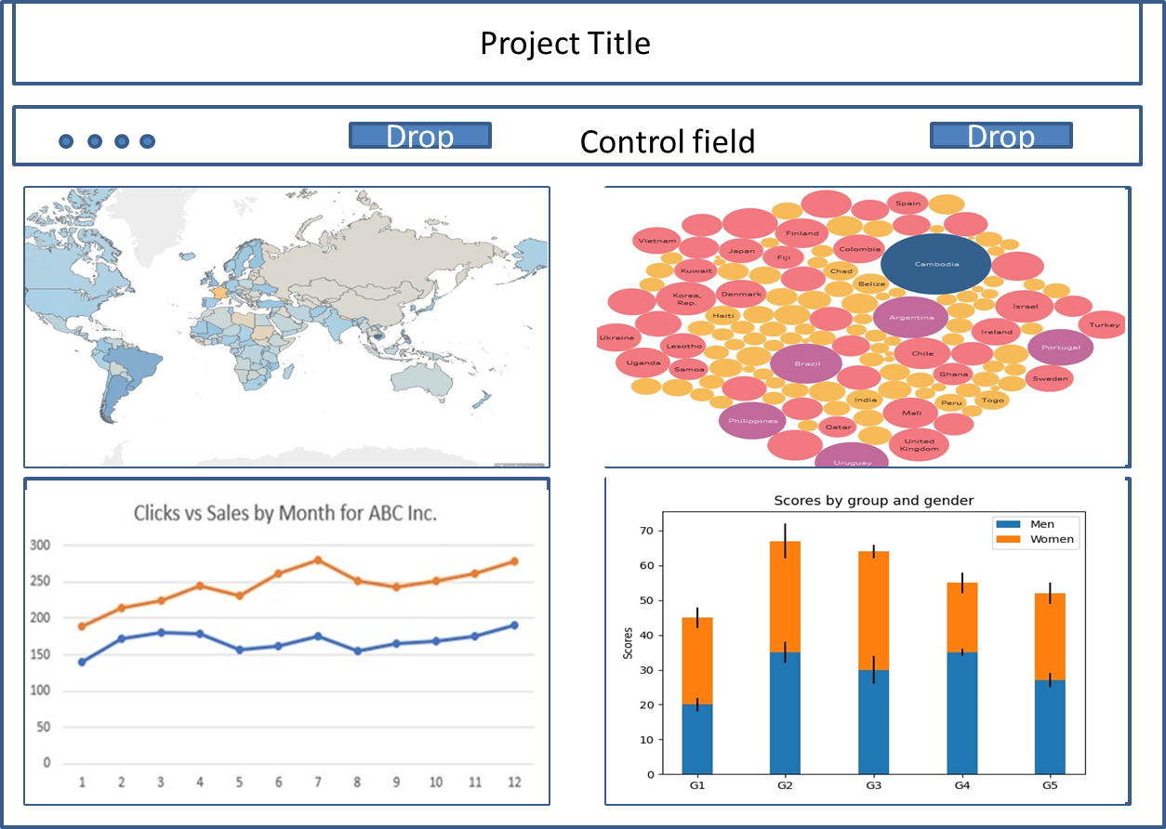
Dashboard design
Figure 1: Prototype dashboard design

Slide 5
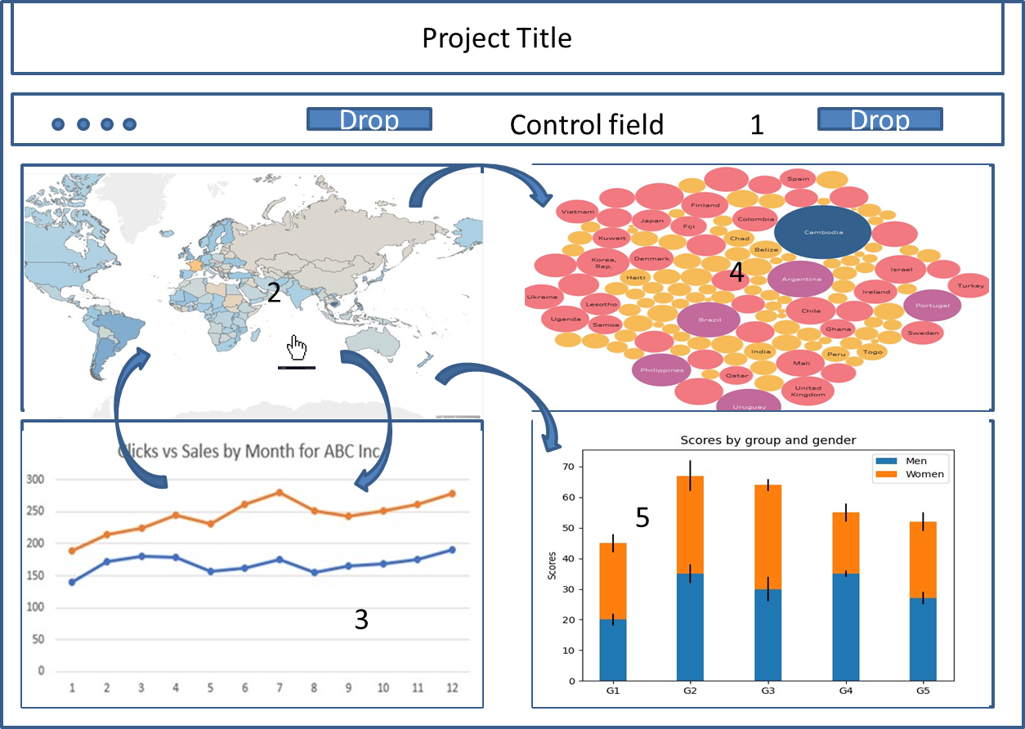
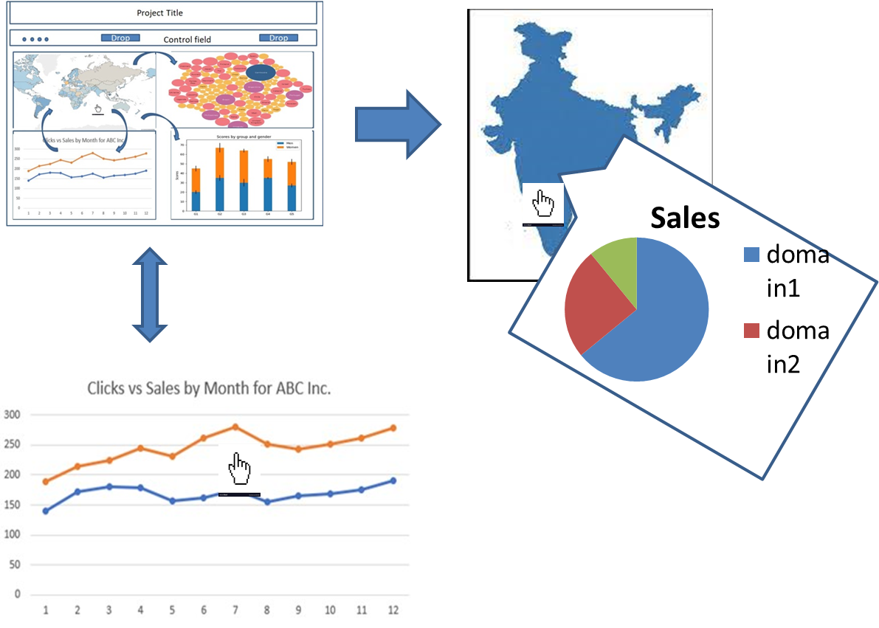
Interactive Story board
Figure 3: drill down
Figure 2: Interactive story

Slide 6
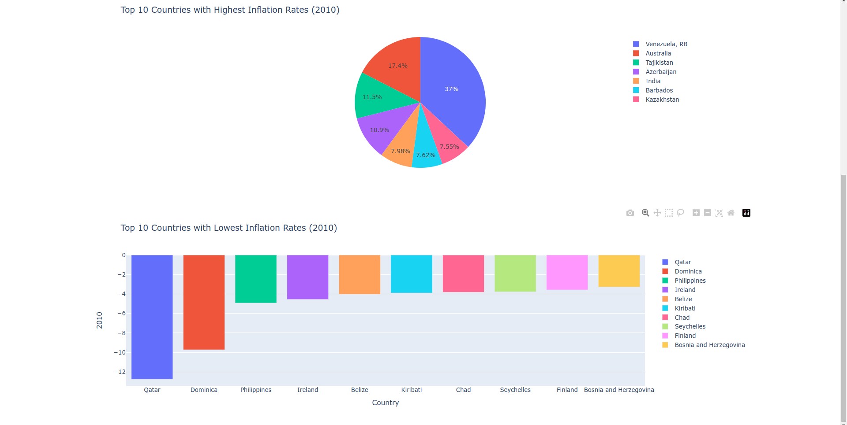
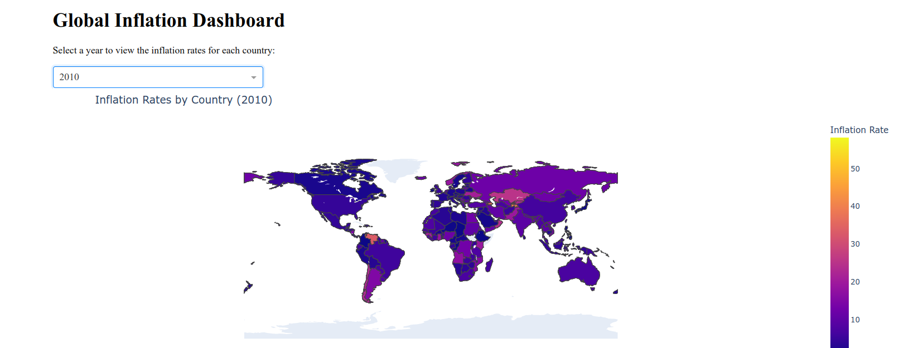
Progress for Increment 1
Figure:4 Dashboard part1
Figure:5 Dashboard part2

Slide 7
Preliminary Analysis
Choropleth makes use of spatial data and is enough for our top level view based on the average inflation rate by country
Further assisted visualisations through pie charts, bar charts, bubble plots, line plots and box plots will provide more options.
In terms of the data itself certain third world countries seem to be having increase in inflation at least on the data upto 2022.

Slide 8
Demo

